Slide 1
GROUP 6
REVIEW 3
LEAN START UP MANAGEMENT - MGT1022
Faculty: Sujatha Manohar

Slide 2

AMBCARE

Slide 3
GROUP MEMBERS
ANGEL SUSAN VINO 20MIA1068
ABHIJAY ANOOP NAIR 20MIA1033
ANTONY GEORGE MATHEW K 20MIA1022
KRISHNENDU S 20MIA1036
NOEL BENNY 20MIA1020
PARVATHY MENON 20MIA1105

Slide 4
AMBCARE
AMBCARE is an online application connecting various kinds of ambulance services to the very doorsteps of those in need of their service.
AMBCARE aims to provide its clients with the preferred type of ambulance, when they want it and where they want it and for what they want it for.
AMBCARE medicine delivery services provide doorstep delivery of medicine without any hassle of standing in a queue, this helps in saving time and money.
AMBCARE provides 24/7 support with instant responses and live time position tracking of the respective service required.
AMBCARE also assist needy with medical team at their doorstep on request.

Slide 5
REMAINING PART OF THE STARTUP EQUATION

Slide 6
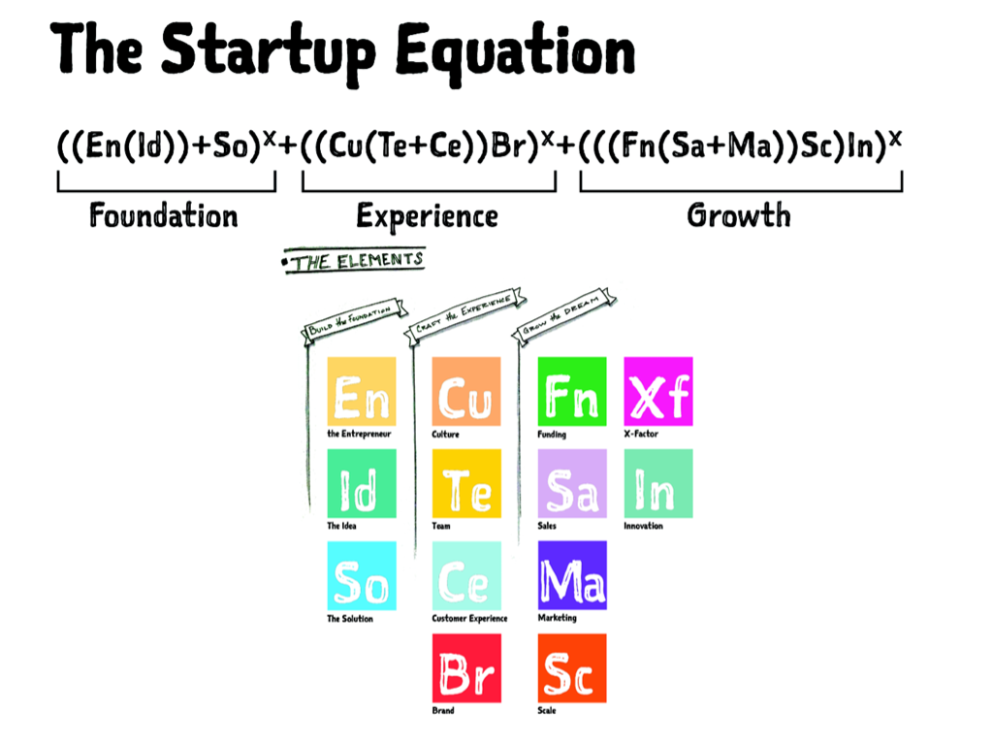
STARTUP EQUATION

Slide 7
Second PART OF THE STARTUP EQUATION Experience
Culture
Team
Customer Experience
Brand

Slide 8
culture
We wish to set a work culture that have a sense of both freedom and responsibility.
We will give the maximum respect to both our users and employees as they are the lifelines of AMBCARE.
We make each of our workstations more comfortable for employees as it can help them to work in more peaceful way.
We would also create flexible work timings and give increments and appraisals for each targets that they achieve .

Slide 9
team
We truly believe that working as a team can bring out great changes and outputs and for that we would like to create beautiful and strong bonding with all our employees .
This can be done by increasing spaces of communication and for that we would like to create a platform where each member of AMBCARE can express their ideas without any boundaries.
We think that innovative and great ideas are always created when people’s mind are at peace , for this we wish to provide them refreshment activities thereby building stress-free environment.

Slide 10
Customer Experience
We at AMBCARE gives utmost importance to our customers. We provide 24/7 the customer feedback system.
Review and Rating system is one of our other major feature.
We take each and every single queries and suggestions of our customers very seriously and will definitely try to solve that for them in every possible manner.
We will train all our employees to work in an efficient way so that our customers get the best experiences from AMBCARE.

Slide 11
Brand
We are planning different ways to make AMBCARE reach all it potential customers including :
Advertising through social media platforms like Instagram ,Facebook, Twitter, LinkedIn etc.
We also plan for advertising it through newspapers and magazines.
We are planning to expand the reach of AMBCARE with the help of our main service providers including hospitals ,clinics , ambulance service centers ,pharmaceutical stores etc.
We will be providing uniforms ,bags and other essential objects to our delivery executives and ambulance service centers with our brand logo embedded on it.

Slide 12
THIRD PART OF THE STARTUP EQUATION GROWTH
Funding
Marketing
Sales
Scale
Innovation

Slide 13
Funding
We will be reaching out different companies such as capital investors to invest in our start up( venture capitalism ).
The government has initiated a few loan schemes to provide collateral-free debt to aspiring entrepreneurs and help them gain access to low-cost capital such as the Startup India Seed Fund Scheme and SIDBI Fund of Funds.
Bootstrapping
We will also try to approach Business /Investors Angels.

Slide 14
Marketing
Promotions through social media platforms, local advertising in and around Kerala.
Showcasing free demos in some popular localities on how to use the app.
Collaborating with local influencers to market our App .
To attract the customer traffic to our application, we provide 25% off on their first Service.
We do provide seasonal offers and coupons for our regular users.
For the first ten bookings, we provide 10% cashback into their in-app wallet (non-transferable) which can be used for their further bookings and services.

Slide 15
Sales and profit expected
From medical shops: Rs.2000(per year)
Ambulance services: Ambulance fares differ with distance to be covered and services offered. So lets assume every user pays Rs.2200 for an ambulance service. We obtain 20% of each transaction as an income.
Medicine delivery: medicine delivery charges also varies with distance from pharmacy to the users location. Lets assume the user pays Rs.60 for delivery(average price including the medicine price and delivery charge). We obtain 20% of each transaction as an income.
From Hospitals: Rs.2000-10000(per year). As an example lets assume a hospital pays Rs.10000 per year.
Advertisements: The average CPM(cost per mile) across all android devices is 2$(Rs.150) and 5$(Rs.375) for all IOS devices.

Slide 16
Sales and profit expected(Cont.)
Income Generated
From hospitals: Lets assume 1200 hospitals use AMBCARE services.
1200*10000 = Rs.1,20,00,000
From medical shops: Lets assume there are 100+ pharmacies using AMBCARE, then
100*2000 = Rs.2,00,000
Ambulance services: let’s say 100 users book ambulance services through our app, then
100*2200 = Rs.2,20,000 per day
2,20,000*365=8,03,00,000 per year
We receive 20% of the above income
20% of 8,03,00,000 = 1,60,60,000 per year

Slide 17
Sales and profit expected(Cont.)
Medicine delivery : Let’s say 100 users book medicine services through our app, then
60*100 = 6000 per day
6000*365 = 21,90,000 per year
We receive 20% of the above income
20% of 21,90,000 = 4,38,000 per year
Advertisement: suppose 100 people click on the ads displayed within the app a day, then
Income generated per day = 150*100 = 15000(android)
375*100 = 37500(IOS)
Taking the average, we obtain (15000+37500)/2 = Rs.26,250 per day
26250*365 = Rs.95,81,250 per year
Total income = 1,20,00,000+2,00,000+1,60,60,000+4,38,000+95,81,250
= Rs.3,82,79,250

Slide 18
Scale
Risk Assessment
We plan to employ the best team for technical support to help in the case of a technical emergency or difficulty (e.g. the app crashes).
There is a risk of un-ethical activities from the part of the medicine delivery executives like theft of prescribed medicines etc. so, to make sure of our customer assurance and safety, we impose strict protocols on our human resources.
We make sure that our application is encrypted to the maximum in order to avoid any loopholes in the payment gateway allowing cyber-crimes.

Slide 19
Scale
Recruits
We would like to recruit our delivery executives and ambulance drivers after completing their background checks and complete verification of their details in order to make customers gain trust on our service.
We also do background checks on hospitals, clinics etc. as well as medical shops to ensure maximum assurance to our customers.
We would like to recruit more like-minded & enthusiastic people for our team who would like to work and improve our AMBCARE application into a much better platform and to eventually lead to making it a one stop medical solution.

Slide 20
SCALE
Diversification
We would like to expand our services in other various cities and states of India in order to save more lives with the help of our AMBCARE application.
We would like to expand our range of services in order to get more reach to public about our application and its wide uses.

Slide 21
Innovation
Brainstorming
Business model canvas
Design thinking
Three in One application
Serving as a bridge between our customers and request providers .
Introducing advanced algorithm to handle all process and management automatically .
Bringing new services to our customers.

Slide 22
X-factor
Our brand stands out with respect to our competitors because of the exceptional quality of our services and the diverse application that our platform offers.
Following strict Covid-19 protocols and hygienic measures by our professionals which automatically attracts customers to our service.
The prices and discounts that we offer for our services also makes us standout from our competitors.
The accumulation of services from both public as well as private sectors help our customers access healthcare facilities of all types.

Slide 23

Interview - 1
1)Would you prefer buying medicines straight from pharmacies or would you spend a little more money and buy medicines through an application like ours?
Ans: I will buy using the app, because sometimes transport facility will not be available to travel to buy medicines and we may need to go to many shops to find the desired medicine which takes too much time . If every medicine is available in the app, I will surely choose this option.
2)Normally how do you call an ambulance when there is an emergency or a need?
Ans: I didn’t face any emergency situation yet. I don’t have any contact details of any ambulance service providers. So only way to get contact details is by googling .
3)Would you prefer calling an ambulance through an application which gives you many options including live tracking etc.?
Ans: I will surely use this app. Not only me but others who needed this kind of help will surely use your app. If we have a app like this with us, we don’t need to waste time googling contact details during emergency. Open your app and get the nearest ambulance asap. This app will be really helpful and I will use it.
4)What is your view on an app like ours?
Ans: The idea is good if this features will also be available to poor people in a affordable manner. The delivery charge for medicine delivery should also be minimum so everyone would use your app. This type of application will be really helpful in this kind of situation(covid).I will surely use this app and also will recommend to my friends.

Slide 24
INTERVIEW - 2
After giving a brief description about AMBCARE and the various services offered by our app, we asked the owner of the pharmacy the following questions:
1)How many of your customers prefer home delivery of medicines?
Ans: Though most customers prefer visiting the pharmacy with a doctors prescription to purchase the medicine, there are some customers who book orders by contacting the pharmacy and the delivery boy delivers the medicines to their houses.
2)What are the general age groups that prefer this kind of a service?
Ans: Most customers visiting the shop generally belong to the age group 50-60 years.
3)Would you prefer to collaborative with an app like ours?
Ans: With most customers preferring home delivery and considering the age group of the majority of customers, it wouldn’t be a bad idea to partner with AMBCARE.
4)What is your view on an app like ours?
Ans: This a very good initiative. Using this app the customers could easily place orders from their own houses and the pharmacy could handle the deliveries more comfortably.

Slide 25
Interview - 3
1)How do you usually call an ambulance during emergency?
Ans: I don’t have numbers of any ambulance drivers yet so I need to search in google in case of emergency.
2)How do you usually buy medicines?
Ans: From a nearby pharmacy or if the medicine is not available there then I need to approach a Pharmacy which is far away from my place.
3) What is your view on an app like ours?
Ans:" Most likely because most of the facilities that you've mentioned is accessible at a place and at a go so it sounds good“.

Slide 26
Interview - 4
1)How do you book an ambulance ?
Ans: By calling 108 or by collecting number from friends’.
2)How do you buy medicine?
Ans: Usually by going to medical shops. I have tried buying medicine from online sometimes but faced some difficulties while going manually especially when it is night.
3) What is your view on an app like ours?
Ans: Most likely, I’d use this app. As it is providing all services in one go.

Slide 27
Thank you

